Slide 1
QSine AI-Powered Food Allergen Detection
Team: Hung Nguyen, Eric Buffington, Kaleb Bishop, and Matthew Bryant
Advisor: Professor Annexstein

Slide 2
Goals
Background
Prevalence of Food Allergies
Food allergies affect millions of individuals worldwide, with common allergens including nuts, dairy, and gluten.
Exposure to allergens can lead to severe reactions such as itchiness and hives
Challenges in Allergen Identification
Many individuals rely on food labels or verbal confirmation in restaurants to determine allergens, which may not always be accurate or available.
Goals
Enhance Food Safety for Individuals with Allergies
Provide a reliable tool to help users identify potential allergens in dishes, reducing the risk of allergic reactions.
Utilize machine learning, image recognition, and natural language processing to provide accurate allergen detection.
Facilitate Fast and Informed Dining Choices
Empower users with comprehensive allergen details to make safe food selections at restaurants or when purchasing meals.
Allows users to quickly identify dishes with allergic risks

Slide 3
Intellectual Merits
Multi-input allergy identification
The project uniquely integrates both image-based and text-based allergen detection, increasing versatility and usability.
QSine employs computer vision techniques to classify dishes and map them to known recipes.
Real-time Food Identification
The app provide a seamless and intuitive experience means to identify allergens
Seamless Data Integration:
The app connect with a structured database of recipes and allergens
Using web scrapers, the database is updated daily to reduce obsolete information

Slide 4
Broader Impacts
This product has clear benefits to society as a whole, with the ability to alert people of potential allergens in their food
By being able to provide this service people who were once scared can now have another way to gain knowledge about what they are eating
Our desired outcome is that this product can potentially saves lives for people with sever allergies, by producing an app that gives them another way to ensure they are staying safe

Slide 5
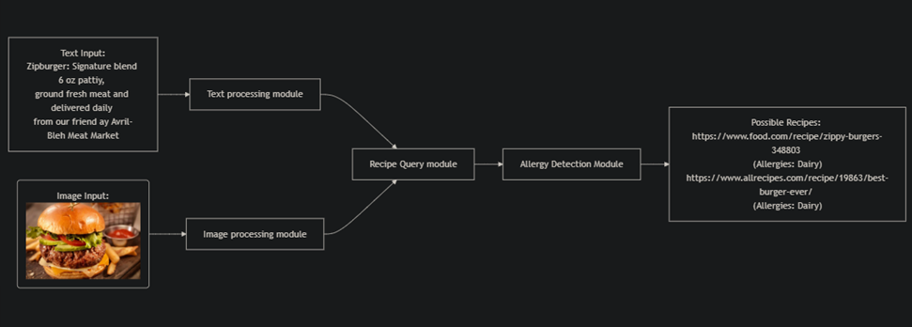
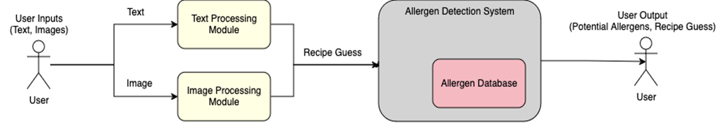
Design Specifications
Design Diagram D1 delves deeper into the Allergen Detection System, outlining its core subsystems and their interactions. This design shows the Text Processing Module, the Image Processing Module, and the Allergen Database. It details how each subsystem handles specific types of input and collaborates to provide accurate allergen detection results.

Slide 6
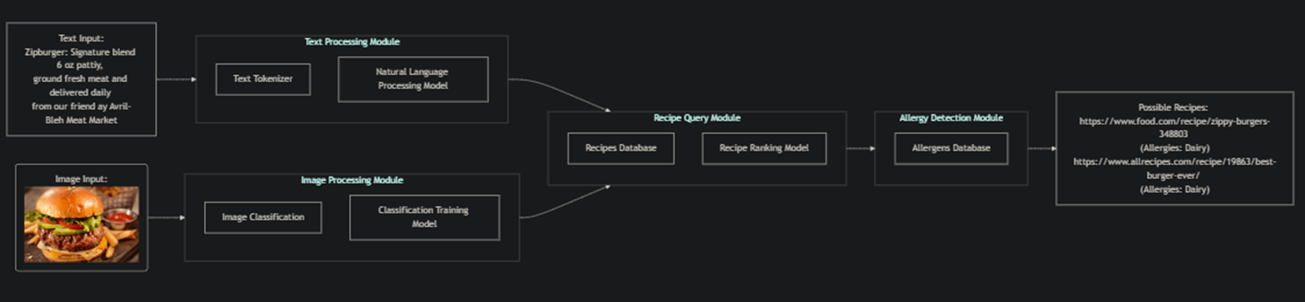
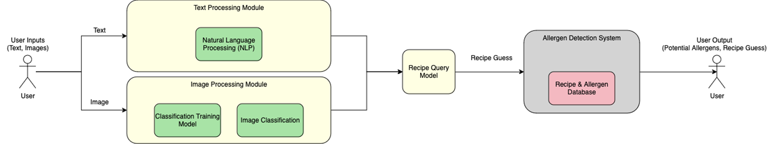
Design Specifications
Design D2 provides an in-depth breakdown of each subsystem within the Allergen Detection System, outlining the internal components and their interactions. This design highlights how data flows through various stages of processing, from initial input through detailed analysis, leading to the generation of an allergen report.

Slide 7
Technologies
Web Scraper
Our app uses a web scraper to obtain data about the foods from websites AllRecipes & Food.com.
This allows use to stay up to date on new recipes. This is done by first parsing out the website link, then parsing an image for that item. All this info is then placed into JSON files.
Image Recognition
Utilizing TensorFlow we have image recognition that allows users to simply take a picture of an item that then will be accessed.
Once the user take a picture it searches the database and compares the name, and picture and lists the top matches.

Slide 8
Milestones
Milestone | Date | Status
Project Setup & Initial Consultation | September 29, 2024 | ✅ Completed
App Design Completion | February 5, 2025 | ⏳ In Progress
Database Build & Populate | February 12, 2025 | ⏳ In Progress
Web Scraper and NLP Integration | February 19, 2025 | ⏳ In Progress
Allergen Detection Model Integration | February 26, 2025 | ⏳ In Progress
Model Training & Testing | March 5, 2025 | 🔜 Upcoming
Final Testing and Performance Optimization | March 26, 2025 | 🔜 Upcoming

Slide 9
Results
Achievements
Functional mobile app prototype with barcode scanning and YOLO powered ai image classification.
User-customizable allergens for more personalized results.
Positive initial feedback from friends and family.
Next Steps
Enhance accuracy of AI image classification.
Improve database coverage for global food items.
Finalize UI design for better user experience.
Prepare a demo for the Expo.

Slide 10
Challenges
Challenge | Solution
Web scraping led to inconsistent food images. | Rescaled all incoming images to 512 x 512 to ensure consistency but retained enough quality for recognition.
Web scraping had many different variations of recipe pages with different parsing requirements. | We used some clever regex to try and generalize our scraping. After adapting to many pages, we decided to ignore future edge case recipe pages.
Barcode database has many inconsistent or missing entries. | By utilizing multiple different databases along with a page on our front-end application for users to modify incorrect data, we can correct for these mistakes.

